Slide 1
Appraisal Writing

Slide 2
Food for thought….
For the past 33 years, I have looked in the mirror every morning and asked myself: 'If today were the last day of my life, would I want to do what I am about to do today?' And whenever the answer has been 'No' for too many days in a row, I know I need to change something
- Steve Jobs

Slide 3
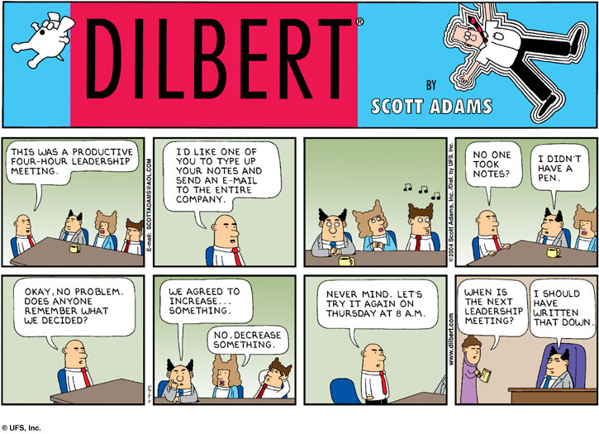
Source: http://keywordsuggest.org/gallery/583122.html

Slide 4

Our Philosophy
We aim to bring out the best in Mindtree Minds through continuous evaluation and developmental feedback
Intent
Means to achieve
Notes:
Some bold/not bold inconsistency here.
The right hand box has center issues (both vert and horiz)
I thought we were defaulting to 16,000+ as MM scale

Slide 5


Defining Ownership & Accountability
Ownership
Goal Setting : Manager-led
Development : Mindtree Mind-led
Feedback : Co-Owned by Manager and Mindtree Mind
Goal-Setting
Feedback
Development
Mindtree Mind-Led
Manager-Led

Slide 6
General Guidelines
Make sure you read the instructions carefully before filling out comments on PACE !!
Guidelines for Appraiser
Make sure you prepare and plan for feedback discussion with your team members and block dedicated time on your calendar
Substantiate your feedback with facts, figures and specific examples
During Mid- year, provide course correction, if needed
During Annual review, be fair and rational while giving out ratings to your team members
Avoid common errors while giving feedback like recency effect
Also talk about development and career aspirations
Adhere to the timelines
Guidelines for Appraisee
Highlight your key accomplishments and seek advice on areas where you are struggling
Receive feedback with an open and positive outlook
Devise an action plan with the help of your manager for your developmental aspects. Make sure you use IDP as a placeholder for all your developmental goals.
Raise an RTF for taking feedback from previous manager or if you work with more than one manager.
Adhere to the timelines

Slide 7
New Inclusions
Rate Quality of Feedback
Option for Mindtree minds to tell us how the feedback discussion went
Ask for Feedback
Option for Managers to ask for feedback from various stakeholders
Right to Feedback
This will not be linked to any cycle, but will be open through out the year.

Slide 8
Hiccups
I wait to the last minute to get started
I don’t really have any stats to prove I’ve done a good job
I cannot stay objective evaluating myself
It takes forever to finish!
Reviews are just formalities. Nobody really looks at them
I don’t know what to write about.
I don’t remember what I’ve done earlier in the year
It feels awkward to talk about my achievements / I feel I will expose my short comings
Once I start I can’t stop writing

Slide 9
Tips
Create a relaxed environment for yourselves before writing
Be objective in evaluating yourself. This will help balance the self appraisal with that of the appraisers
Focus on results and the process used
If any objective has been dropped during the year – mention the reason
Maintain a log of accomplishments, challenges, customer appreciation, peer feedback. (if not, time to check your email history & archives)
Focus on improvement areas as well and what action did you take?
Be precise and to the point, do not elaborate. Don’t be too concise either (Facts are very important)
Check for Spelling ,Grammar , Tone and Clarity !

Slide 10
Quick Tips on Writing Self Appraisals
While entering your Self Comments, document your:
Metric to be measured –Plan / Actual
What went well, what could be better
Provide tangible inputs -facts & figures to the appraiser to assess your performance. Attempt highlighting benefits to the Organization.
Reporting on implementation should highlight whether time deadlines were achieved or not. It can also highlight hurdles, issues or dependencies that were faced and how these were overcome.
Write in First Person and use a Professional Tone (Eg: My contribution to the project ensured cost reduction by ‘X $ )
Explain (in brevity) details with regard to your achievements. Keep your comments crisp & to the point.

Slide 11
A good comment
"I responded to 100 % of queries within 48 hours" is better than just saying "My customer service was good”. – be objective
“Interfaced with reporting team” isn’t as good as “Spent a week with reporting team helping integrate with version 3.1 of database views.”
“Used ____ methods to test and identify ____ number of defect over the 12 month period” is better than “Testing and identifying defects that affects the project”

Slide 12
Beware of Errors in Self Appraisals
Leaving the self appraisal column blank.
Getting too detailed and writing paragraphs to explain the achievements.
Do not provide single line self appraisal which are very generic
Do not go overboard on justifying why a particular objective was not met.
Making comments which are not relevant to the objective or appraisal.
No data provided on the measurement criteria identified for the objective.

Slide 13
Appraisal Scores
Understand the rating scale well.
Rating | Performers Description | Scale Description
5 | Distinguished Contributor | Performance far exceeds the agreed expectations in all areas of responsibilities with superior result. Made exceptional or unique contributions throughout and have a line on visibility in larger forums
4.5 | Outstanding Contributor | Performance consistently exceeds agreed expectations in all areas of responsibility
4 | Significant Contributor | Performance consistently meets the agreed expectations in all areas and exceeds in some areas of responsibility
3.5 | Valued Contributor | Performance meets agreed expectations in all areas of responsibility
3 | Learning Contributor | Performance meets the agreed expectations in most areas and falls short in a few areas
<=2.5 | Non-contributor | Performance falls significantly short of agreed expectations in most or all areas

Slide 14
Annual cycle Timelines
Annual Appraisal Milestone | Mindtree Minds from T4-C12 onwards with DOJ on or before 31 Dec, 2016
Right to Feedback initiation date | Upto 8-Mar-2017
Right to Feedback & closure date for Managers / Appraisers | Upto 10-Mar-2017
Annual appraisals self- comments submission by Mindtree minds | 27-Feb-2017 to 8-Mar-2017
Ask for Feedback initiation date* | Upto 17-Mar-2017
Annual Manager Comments Submission | Upto 24-Mar-2017
Sign off by the business/ function leadership | 27-Mar-2107 to 7-Apr-2017
Manager-Appraisee 1:1 discussion on the appraisal comments and ratings | 10-Apr-2017 to 21-Apr-2017
Release of Annual Appraisals | Upto 25-Apr-2017
Grievance Handling and Sign off on Appraisal Release | 5-May-17
Adherence to timelines is of essence !!
*Managers can ask for feedback for Mindtree Minds, after the self-comments are submitted to them

Slide 15
Default Handling – Actions and Consequences
Action | Applicable to | Impact on Ratings | Impact on Increments | Impact on Recognition | Impact on Promotion
Self-Comments not Completed by Mindtree Mind | Mindtree Mind (Appraisee) | No Rating | No Increment | Not considered for recognition programs such as Pillars or its equivalent and other development courses | Not Considered for promotion – will miss one cycle
Review Comments not completed by Manager for all team members | Manager (Appraiser) | Not Applicable | No Increment | Not considered for recognition programs such as Pillars or its equivalent and other development courses | Not Considered for promotion – will miss one cycle
 | Mindtree Mind (Appraisee) | Not Rated | Increment will be recommended collectively by Manager and Biz PF | Will be considered for Recognition and other developmental programs | No Impact

Slide 16
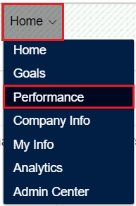
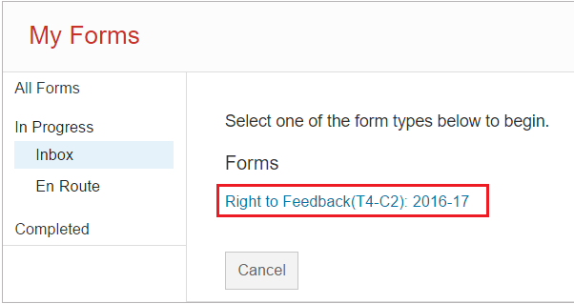
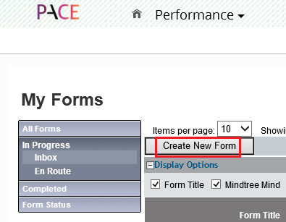
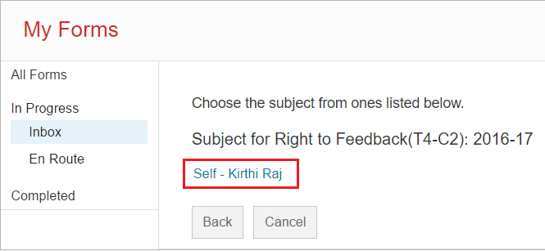
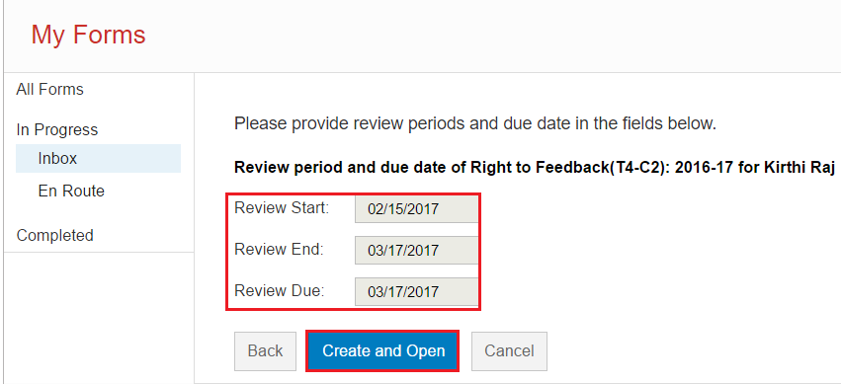
PACE Process_RTF

Slide 17
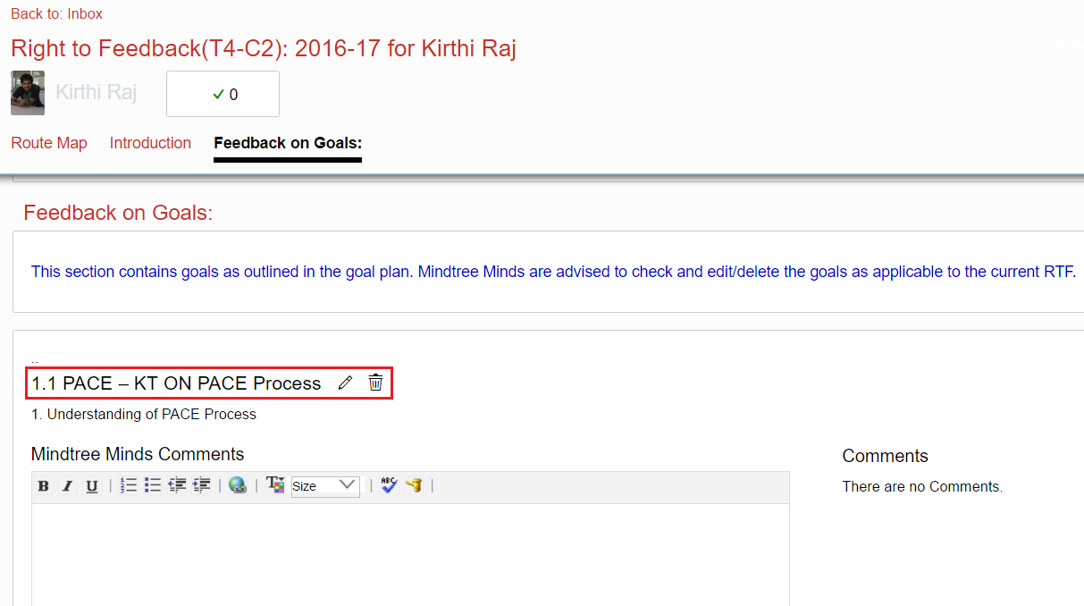
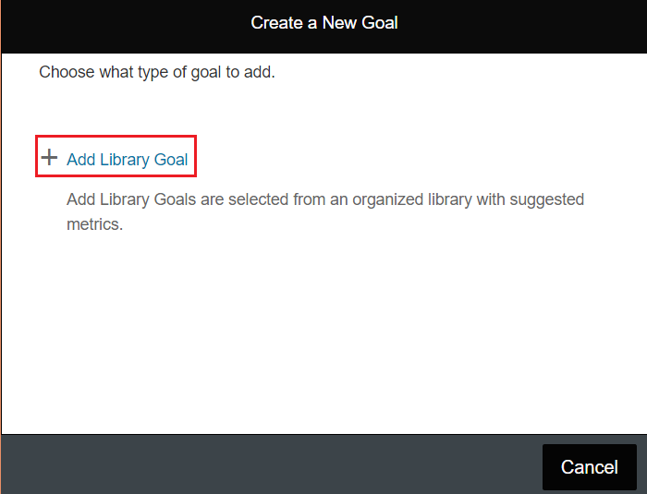
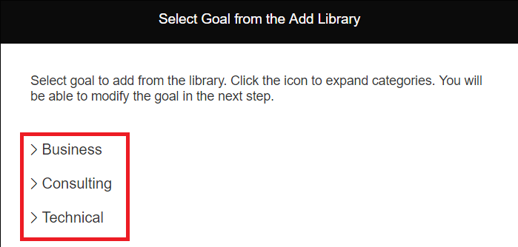
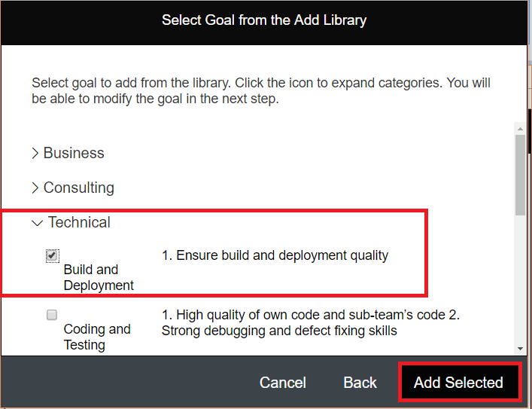
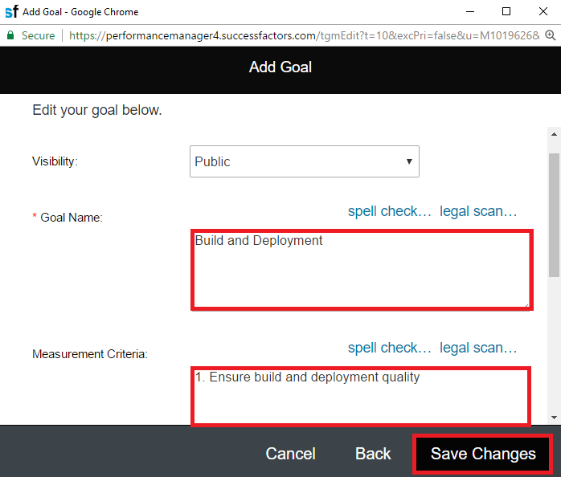
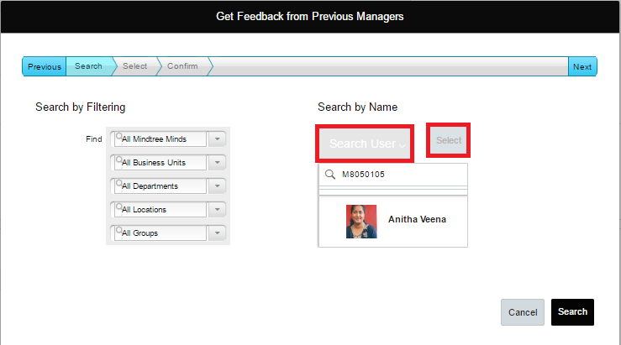
PACE Process_RTF

Slide 18
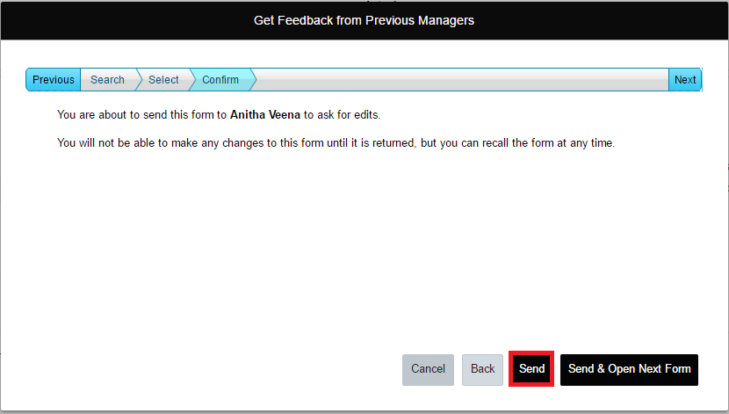
PACE Process_RTF

Slide 19
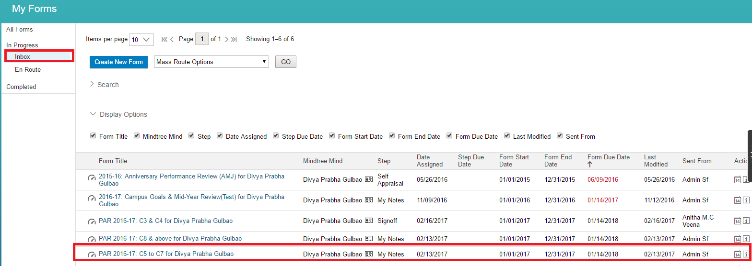
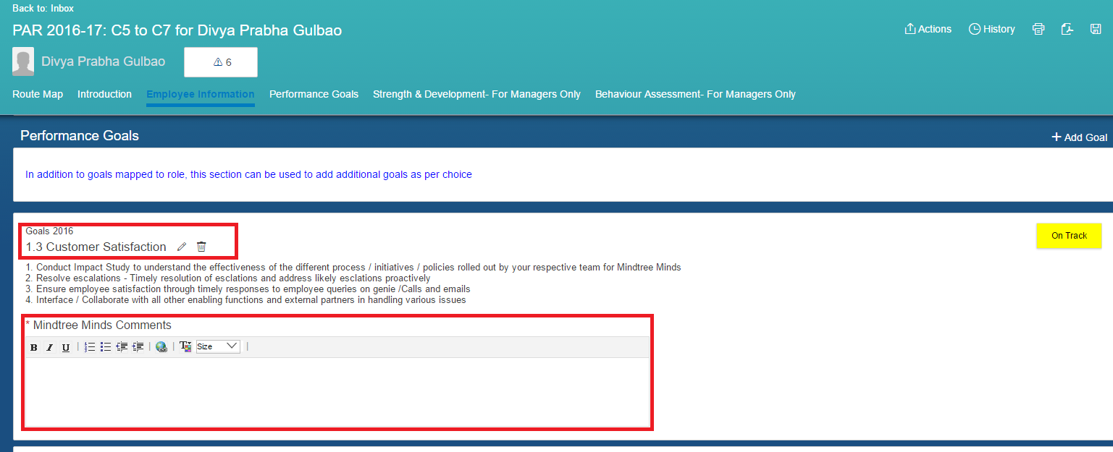
PACE Process_Appraisal Writing
My Notes
Manager's Review
Signoff by business/function leadership
Completed
Discussion
Signoff

Slide 20
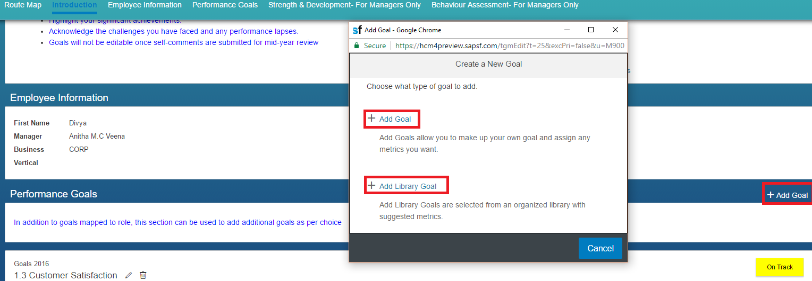
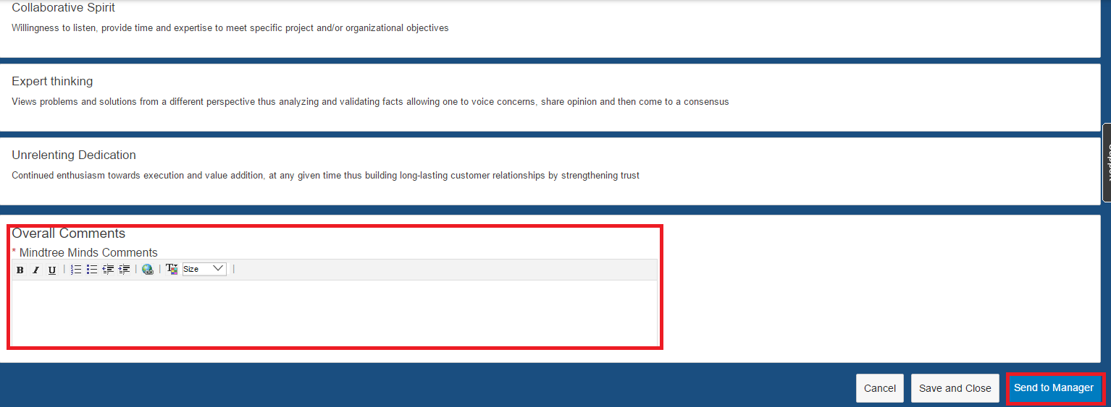
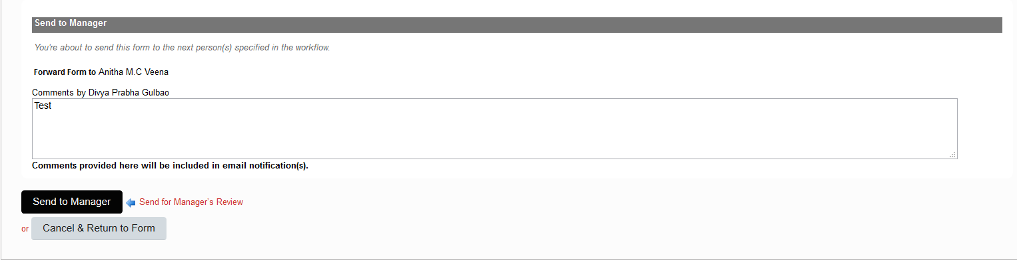
PACE Process_Appraisal Writing

